Slide 1
Conditional Statements & Loops in Python
SESSION 4: 8th August 2024
Presented by - Vaishnavi Venkat
3rd yr AIE

Slide 2
CONTENT COURTESY CREDITS :
W3 SCHOOLS
YouTube lectures on python

Slide 3
PYTHON CONDITIONS AND IF STATEMENTS
Python supports the usual logical conditions from mathematics mostly in IF STATEMENT AND LOOPS
Equals: a == b
Not Equals: a != b
Less than: a < b
Less than or equal to: a <= b
Greater than: a > b
Greater than or equal to: a >= b
THE IF STATEMENTS ARE WRITTEN USING “if” keyword

Slide 4
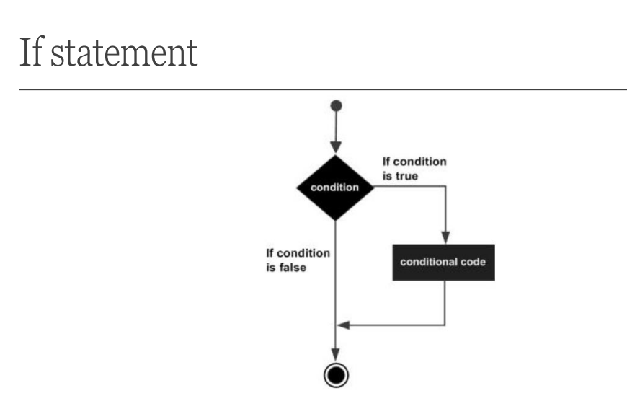

Slide 5
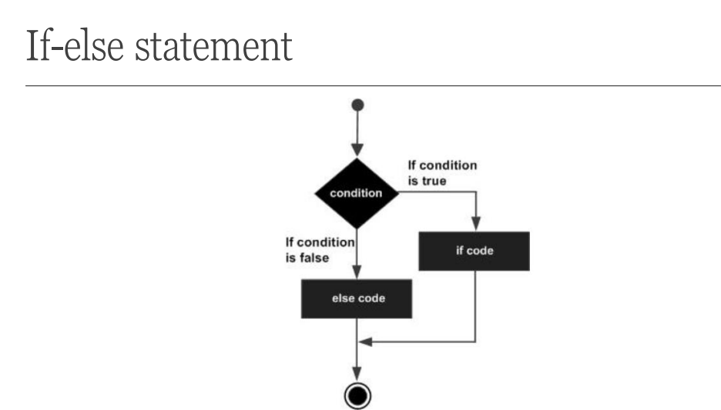

Slide 6
ELSE ..,IF - elif
The elif keyword is Python's way of saying "if the previous conditions were not true, then try this condition".
a = 33
b = 33
if b > a:
print("b is greater than a")
elif a == b:
print("a and b are equal")

Slide 7
ELSE
The else keyword catches anything which isn't caught by the preceding conditions.
a = 200
b = 33
if b > a:
print("b is greater than a")
elif a == b:
print("a and b are equal")
else:
print("a is greater than b")

Slide 8
SHORTHAND IF
If you have only one statement to execute, you can put it on the same line as the if statement.
if a > b: print("a is greater than b")

Slide 9
AND, OR ,NOT
AND - BOTH THE CONDITIONS ARE TRUE - and
OR - AT LEAST ONE CONDITION IS TRUE - or
NOT - USED TO REVERSE THE RESULT - not

Slide 10
NESTED IF
You can have if statements inside if statements, this is called nested if statements.
x = 41
if x > 10:
print("Above ten,")
if x > 20:
print("and also above 20!")
else:
print("but not above 20.")

Slide 11
WHILE LOOPS
With the while loop we can execute a set of statements as long as a condition is true.
i = 1
while i < 6:
print(i)
i += 1

Slide 12
